Slide 1

Batch-09
Smart ClassRoom Monitoring System and Timetable Alerts Using Deep Learning
Under the guidance of
Dr.P.K.VenkateswaraLal, Ph.D, Professor
SUBMITTED BY:
P.JASMINE(22F11A0541)
CH.VARSHITHA(22F11A0512)
M.DIVYA SRI(22F11A0530)
E.TEJASWANI(22F11A0516)

Slide 2
LITERATURE OVERVIEW
Several studies have explored automated classroom monitoring systems using Biometric systems, and IoT-based solutions.
Biometric systems such as fingerprint recognition require physical contact, raising hygiene and usability concerns.
Some vision-based systems use continuous video surveillance, which causes privacy concerns.
Existing reminder systems are not integrated with real-time classroom supervision.

Slide 3
DaTA COLLECtion
Faculty face images collected during registration.
Multiple images captured under different lighting conditions.
Registered images stored securely in the local database.
Faculty timetable data collected from department schedules.

Slide 4
DATA PREPROCESSING
Face images resized and normalized.
Noise removal and image enhancement using OpenCV.
Face encoding generated for each faculty.
Duplicate and low-quality images removed.
Registered and Recognized images are compared.
Registered Image is updated in the website.

Slide 5
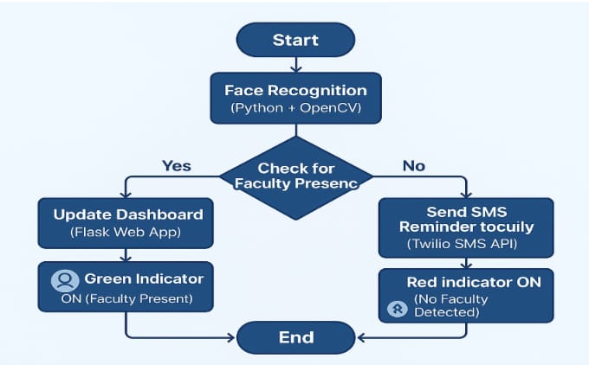
PROPOSED METHODOLOGY
Faculty registration and face data collection.
Face detection using OpenCV.
Face recognition using deep learning techniques.
Update presence status in database.
Display classroom status on dashboard.
Send SMS alerts based on timetable.

Slide 6
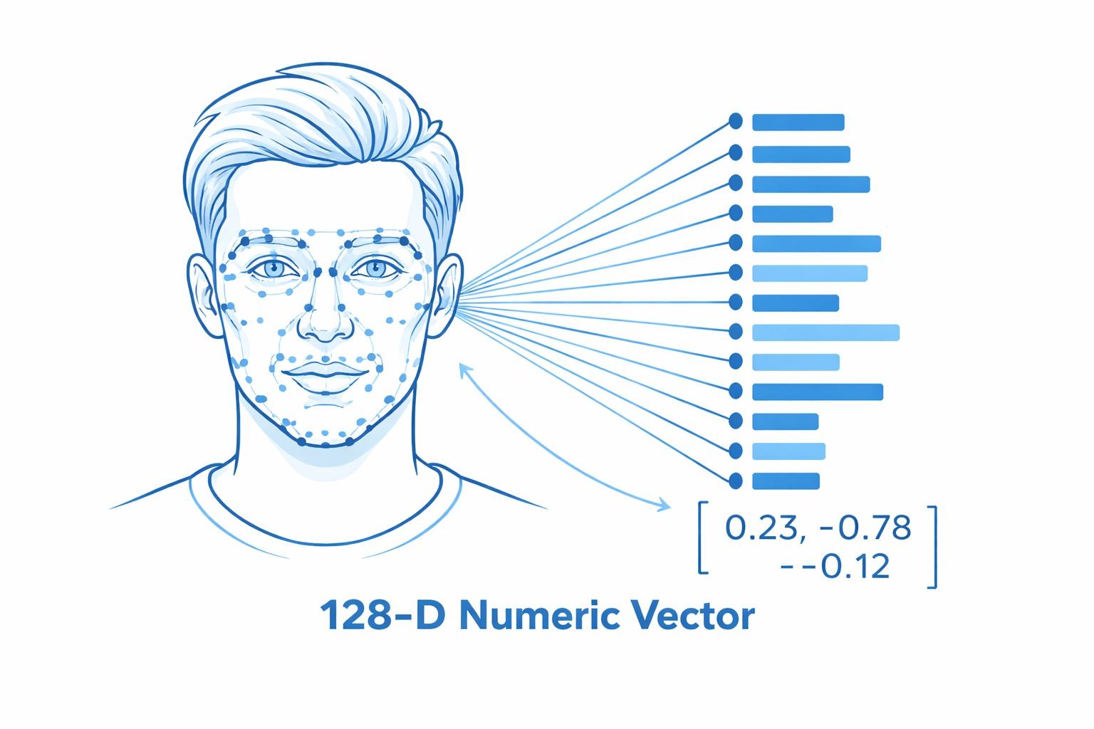
Deep Learning - based Face Embedding Model (128-D Face Encoding)
The face encoding model converts each detected face into a 128-dimensional numerical vector. These vectors represent unique facial features and are used for accurate face comparison.
FUNCTIONALITY:
A 128-D numeric vector is a list of 128 numbers that uniquely represents a person’s face.
[0.12, -0.34, 0.87, 0.05, ..., -0.22] → total 128 values
Each number captures some facial feature, such as:
Distance between eyes
Shape of nose
Jawline structure
Facial symmetry
Texture patterns
LIMITATION:
Requires clear face images

Slide 7
MACHINE LEARNING MODELS USED
HOG (Histogram of Oriented Gradients) based Face Detection Model
Converts the image to grayscale internally
Extracts gradient features
Slides a detection window across the image
Identifies regions resembling a human face
Euclidean Distance-based Face Matching Model
Compares live face encoding with stored encodings
Returns the closest matching face
Confirms identity if distance is within tolerance
CV LIBRARY
OpenCV
OpenCV is a computer vision library which is used to :
Accesses webcam
Captures frames
Converts image color formats (rgb2gray)

Slide 8
TIMETABLE-BASED ALERT MECHANISM
Timetable stored in database.
System checks upcoming classes.
SMS alert sent before class time.
Admin notified if faculty is absent.

Slide 9
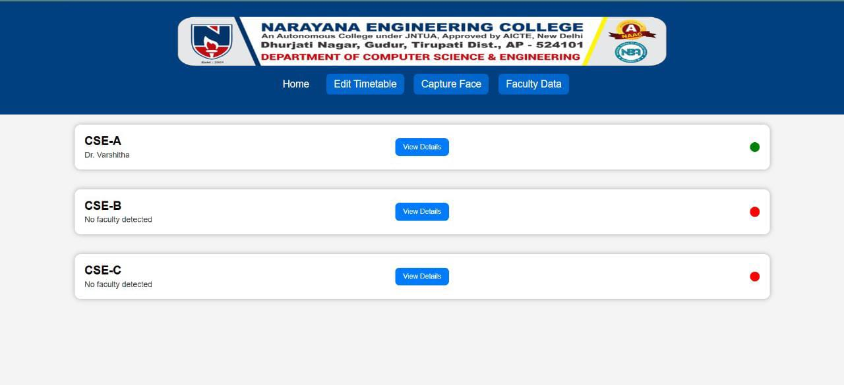
WEB DASHBOARD MONITORING

Slide 10
Future ENhancements
Integrate automatic faculty weekly report generation.
Role-based management according to admin and faculty.
Extend the system to support multiple classrooms and cameras.
Deploy the system on cloud for large-scale datasets.
Enhance face recognition accuracy using advanced deep learning models.

Slide 11
CONCLUSION
This project proposes a smart classroom monitoring system using face recognition and timetable-based SMS alerts to automate classroom supervision. It provides real-time classroom status through a web dashboard while ensuring faculty privacy by avoiding continuous surveillance. The system improves faculty punctuality, reduces manual monitoring, and is scalable for modern educational institutions.

Slide 12
THANK YOU

